Slide 1
Week 2
Week 1
Debate Basics

Slide 2
What is Debate?
Essentially structured arguing
Two sides, one “for” a motion (topic) and one “against” it

Slide 3
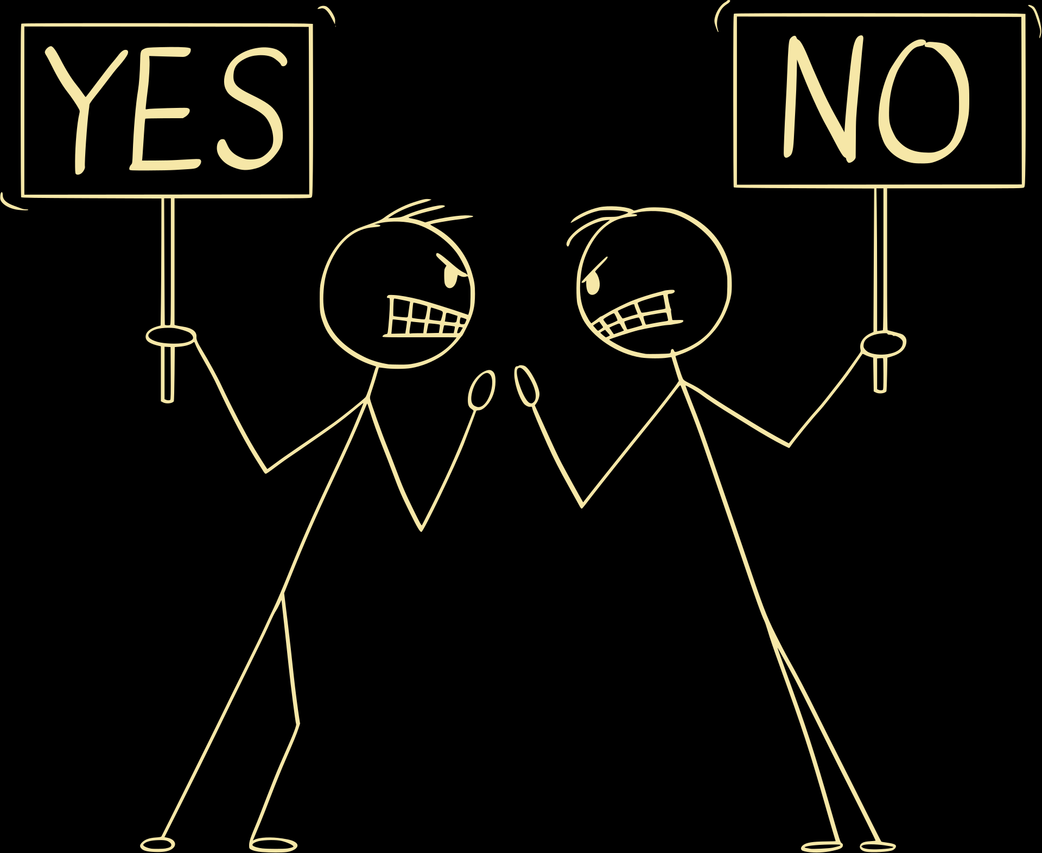
How To Argue

Slide 4

PAEIL Structure
Point
Analysis
Example
Impact
Link

Slide 5
PAEIL Structure
Point: Your argument
Analysis: An explanation of your analysis
Example: A real-life or theoretical scenario in which your argument is, has been, or will be impactful
Impact: How your argument and the scenario it’s in affects people involved in the issue (called stakeholders)
Link: A connection back to the main focus of the debate

Slide 6
PAEIL Structure
Example motion: This house would ban zoos.
Point: Zoos prevent animals from being able to survive in their natural habitats.
Analysis: Zoo animals are treated differently to how they are in the wild, and are exposed to different climates than they would be in their natural habitats.
Example: Animals who have been in captivity since they were young are often unable to acquire food on their own, since they become used to having food handed to them by their human caretakers.
Impact: These animals often cannot be released into the wild, as they will not survive in these different conditions. This is especially detrimental to endangered animals, who are often kept in zoos to prevent them from going extinct, since they cannot be safely released even once their population increases. This decreases the quality of life of these animals.
Link: Since zoos have such a negative impact on the ability of animals to survive in the wild, this house would ban zoos to prevent these effects.

Slide 7

Stakeholders
Stakeholder: A party that is impacted by a motion
Common examples:
The government
Minority groups (e.g. gender minorities, cultural minorities)
Businesses/firms
When determining stakeholders, try to narrow it down to be as specific as possible (e.g. pharmaceutical companies instead of companies in general)
*Your arguments should be centered around stakeholders.*

Slide 8
Stakeholders
Types of Stakeholders:
Voluntary
Individuals/groups who are similar (in a way relevant to the point), and are impacted similarly
Impacted due to their choices; can change their impacts by changing their behaviour
Non-Voluntary
People who are only similar in ways they cannot change
Impacted due to who they are, not due to their choices
Cannot change their impacts by changing their behaviour

Slide 9
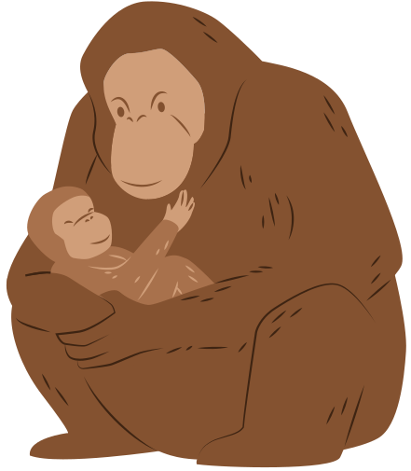

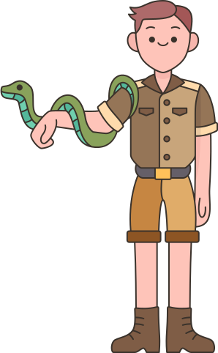
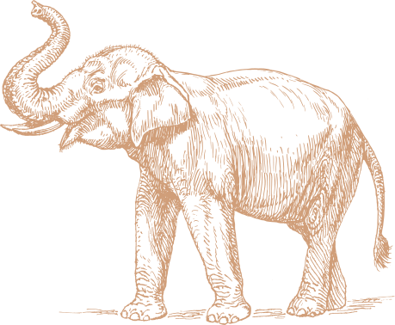

Stakeholders
Example motion: This house would ban zoos.
Stakeholders:
Zoo animals
Endangered animals
Zoo visitors
Young children
Zoo companies
Employees
Animal food companies
Taxpayers, if the zoo is government-funded

Slide 10
Refutation
Refutation: Replies to the other side’s comments.

Slide 11
Refutation
The Five I’s
Incorrect: It is wrong
Illogical: It doesn’t make sense
Irrelevant: It doesn’t matter
Insignificant: It doesn’t have large impacts on the motion
Immoral: It’s unethical

